Slide 1

Krishna Sasank -Presentor
Deepthi Rajagopalan
Prasnnajit
Prasaanth
Ravi
Shivam
Sravani
Sruja

Slide 2
How we started off..(Recap)
Initially MyTab was targeted towards social media websites.
Due to the issues with technical infeasibility, we now focus on a more direct target of integrating accounts of large institutions like universities

Slide 3
Current Scope
MyTab will now be a subscription based application which can be contracted out to any organization that requires it.
For the purpose of this project we will be working under the assumption that Cornell has contracted with MyTab as an account management vendor, thus eliminating any legal concerns(As proposed by Jay and agreed by Prof Arms).

Slide 4
Progress since last milestone
Modularizing and decoupling the overall system architecture(diagram in next slide)
The application deployment for separate clients should be with as less code change as possible.
Investigating and incorporating security measures
Minor UI changes
Added edit and remove account functionality
Made changes to logo as requested by the client

Slide 5
System Architecture(High level)
We use the bridge design pattern to allow loose coupling among the sub-systems.
We have a generic MyTab UI shell that can be customized according to the needs of the institution through adding new refined abstractions.
We have two separate subsystems, one for rendering the appropriate linked account(MyTab would communicate with respective servers to render the accounts), and other for the database tier.

Slide 6
System Architecture(High level)
A separate rendering subsystem allows the client to add/remove accounts according to his needs.
A separate database component allows the client to switch between the databases he desires.

Slide 7
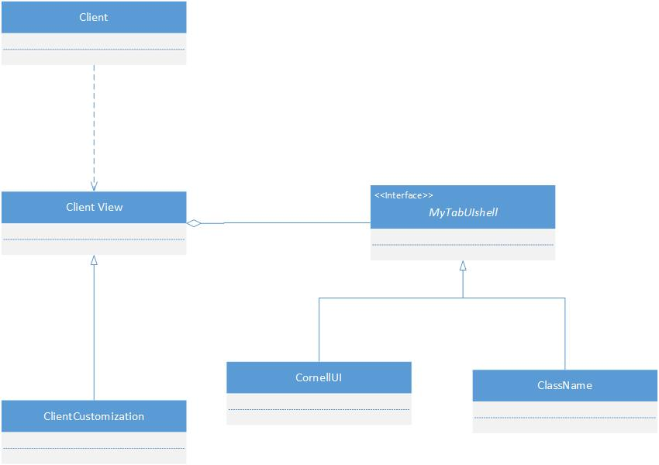
System Architecture(High level) Bridge design pattern
Notes:
ClientView is the complete MyTab UI. This includes the interface elements created by MyTab shell and the elements generated by the CornellUI(concrete class)
ClientCustomization allows the client to customize the MyTab UI. For example, the user might want to change color scheme to red(Cornell)

Slide 8
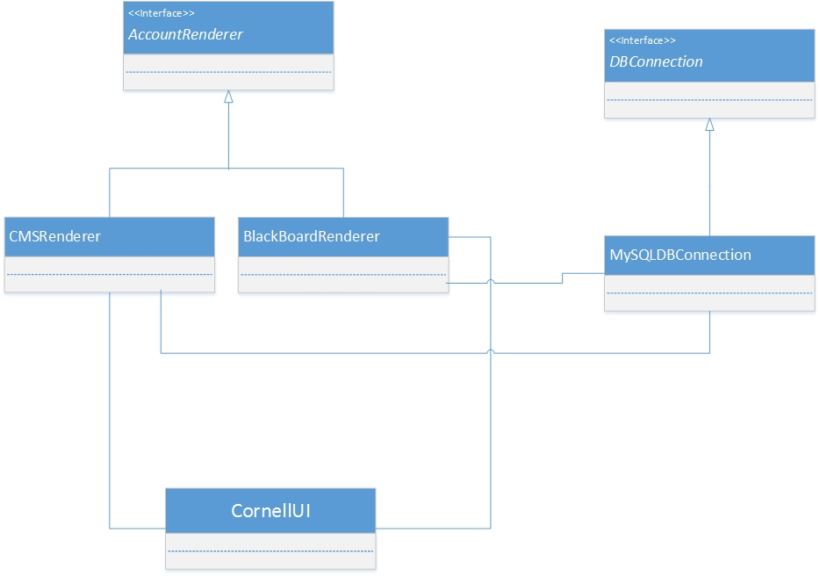
System Architecture(High level)

Slide 9
Security Measures
Two foremost security aspects for our applications are
Secure Network Transmission
Secure Application Code

Slide 10
Secure Network Transmission
Secure Socket Layer(SSL)
Industry standard encryption
We have enabled SSL on our locally deployed web-server by using a self signed certificate.
We use OpenSSL library, ssl_module in Apache and php_openssl in the php engine.
Enabling SSL on production server is a fairly trivial process.
The client will have to buy a proper SSL certificate from a recognized Certificate and install on his production server.

Slide 11
Secure Application code Cookie authentication
Possible threat of session hijacking
For this purpose we tie session cookies to the IP address of the user who originally logged in, and only permit that IP to use that cookie.
We assign random, nonsequential session IDs and re-authenticate when performing any high-security-critical workflow, such as credential change..etc. This behavior is seen is popular websites, such as Facebook

Slide 12
Secure Application code Prevention against XSS
XSS(Cross Site Scripting), one of the major web-application vulnerability
Measures taken to curb
Same origin Policy( Server configuration)
HTML escaping to display untrusted data

Slide 13
Secure Application code Code obfuscation
Easily readable code more vulnerable to attacks
Solution : Code obfuscation
Currently we are using YUI Compressor open source tool provided by Yahoo, for our code obfuscation needs

Slide 14
Other security measures
Sanitized SQL queries to prevent SQL injections, using prepared statements with validation..etc
Prevent directory listing
Vulnerability testing with popular open-source tools like Nikto2

Slide 15
User Acceptance Testing
Testing by releasing a public beta among the Cornell Students
Tentative release date is last week of November
Incorporation of user-feedback

Slide 16
Goals for next milestone
Code completion
System Testing
User acceptance testing
Code documentation
Discuss delivery options with the client

Slide 17
Thank You

